Slide 1
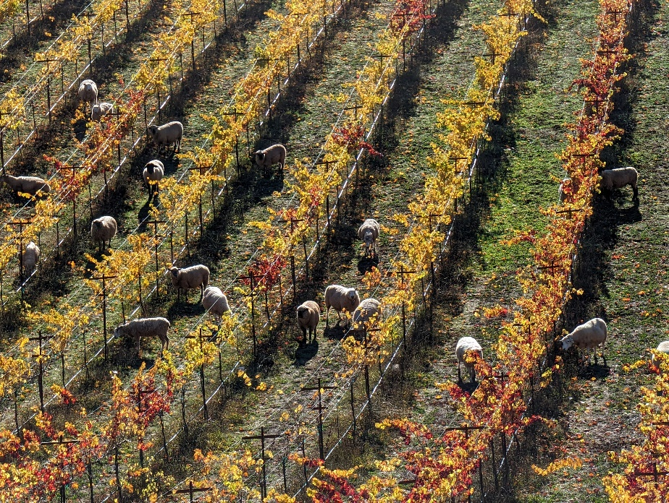
Incorporating Livestock in Foothill Vineyard Systems
Dan Macon UCCE Livestock & Natural Resources Advisor
Placer-Nevada-Sutter-Yuba
June 26, 2024

Slide 2
Overview
Background and Introduction
What do we know about grazing impacts on soil health?
Grazing cover crops
Integrated Sheep-Vineyard Management (ISV)
Practical Applications
Principles of grazing management
Grazing and vineyard infrastructure
Labor needs
Protecting sheep from predators
Questions

Slide 3
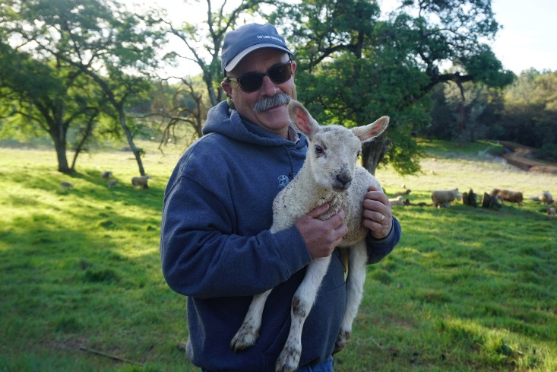
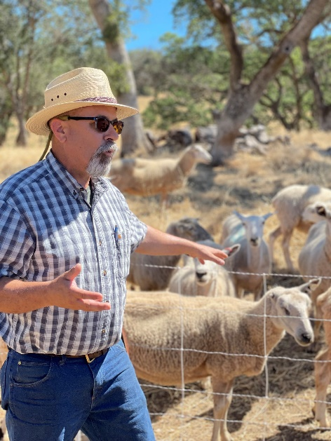
Introduction and Background
Professional Background
Livestock & Natural Resources Advisor (since 2017)
Assistant Specialist (UC Rangelands – 2015-2017)
Masters in Integrated Resource Management (Colorado State University)
Bachelors in Agricultural Economics (UC Davis)
Personal Background
Co-Owner, Flying Mule Sheep Company (2005-Present)
Operations Manager, McCormack Sheep and Grain (2014)
Project Manager, Prescriptive Livestock Services (2011-2013)

Slide 4
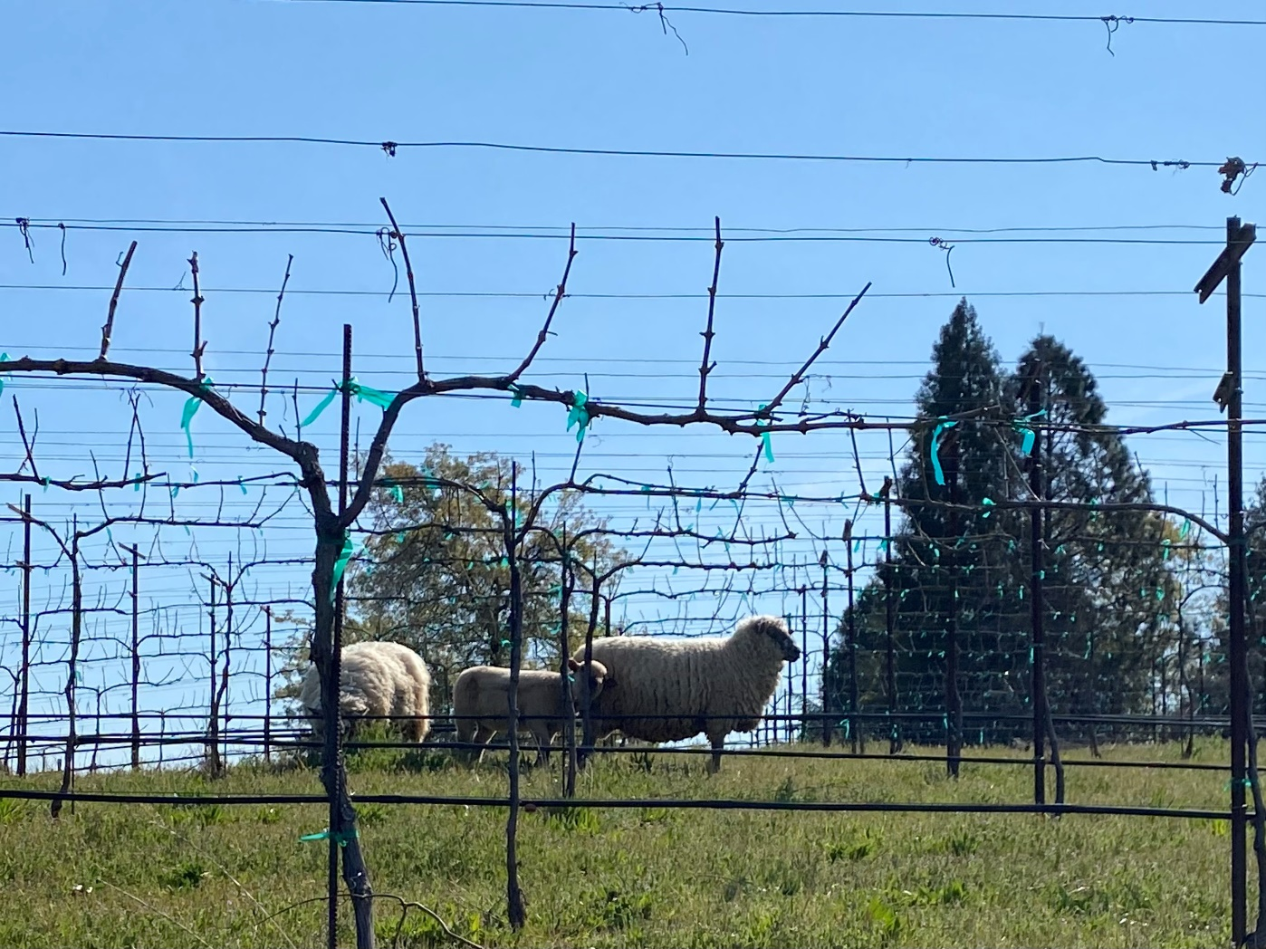
Vineyard Grazing near Auburn, CA

Slide 5
Grazing Impacts
Grazing impacts plants/landscapes in 3 ways:
Consumption
Trampling
Manure/urine deposition
Does grazing ADD nutrients?

Slide 6
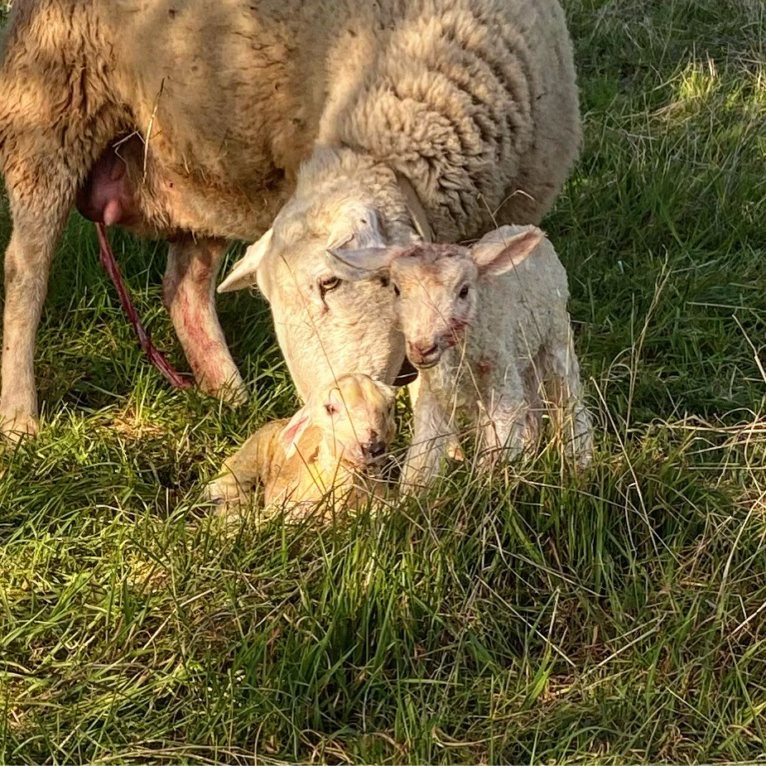
Crop-Livestock Integration – what does the science tell us?
Measures of soil health
Carbon pools
Microbial communities
Nutrient cycles
Soil structure
Salinity
Grazing management
Management-intensive grazing vs set-stock grazing
Food safety
Pathogen risks

Slide 7
Grazing Cover Crops
2019-2022 winter cover crop grazing experiment (Gaudin Agroecology Lab, UCD)
Increased bioavailability of N
Trends towards higher microbial activity
No difference in soil structure or compaction (bulk density)
Weed suppression (barnyard grass)
Higher rainfall and lower soil temps associated with greater generic E. coli risk (90-120 days between application and harvest appears to be sufficient)

Slide 8
Integrated Sheep-Vineyard Management
Gaudin Agroecology Lab – compare intensively grazed (10+ years) and conventionally managed vineyards in 4 locations.
Long-term grazing increased soil carbon sequestration (at 3 depth zones)
Soil microbial communities larger and more active
Soil N and P availability increased
No difference in soil structure
Surface soils showed significant increase in salt content in grazed vineyards (possible tradeoff)
Did not compare different grazing management strategies

Slide 9
Practical Applications of Sheep in Vineyards
Vineyard Goals
Sheep Producer Goals
Cover crop termination
Weed management
Soil health
Reduce fuel costs
Marketing/public relations
Others?
Lamb production (nutrition focused on reproduction)
Fiber production (wool quality)
Filling gaps in the forage calendar
Revenue from grazing services
Others?

Slide 10
Practical Application of Sheep in Vineyards
Principles of Managed Grazing
Adjust rest periods to match the growth rate of the plants
Use the shortest graze period possible while maintaining adequate rest
Use the highest stock density possible
Use the largest herd/flock size possible consistent with sound animal husbandry practices
Adjust stocking rate to seasonal and annual changes in carrying capacity.
Grazing Management – key considerations
Timing
Duration
Intensity
Season
Frequency

Slide 11
Practical Application of Sheep in Vineyards
Grazing Management
High density, short duration grazing likely increases uniformity of impact during rapid forage growth (or during low palatability phases)
Set-stocking post-harvest or during winter may help with springtime cover crop termination
Stocking rate is only a consideration if sheep will be on property year-round.

Slide 12
Infrastructure
Permanent vs. temporary fencing
Stock water
Loading facilities and access
Trellis and irrigation systems
Short-term vs. year-round flock?

Slide 13
Rent vs. Own
Renting Sheep
Owning Sheep
Someone else deals with animal health, shearing, fencing, annual forage calendar, etc.
Can potentially mobilize large numbers to move through vineyard more quickly.
Operator typically provides infrastructure
Always available when needed.
Acclimated to specific vegetation and management system.

Slide 14
Labor Requirements
Sheep are typically more labor-intensive than cattle
Need to handle every animal 4-5 times per year
Vaccinations
Lambing
Shearing
Weaning
Pre-breeding
Predator protection (feeding LGDs, etc.) requires daily labor
“If you see your sheep every day, you rarely see any problems!”

Slide 15
A Note on Sheep Breeds…
Hair vs. Wool Sheep
The Numbers Game – are there enough sheep of a particular breed?
Baby-doll Southdowns
Is flocking behavior important?
Grazing behavior (nature vs. nurture)

Slide 16
Everything Likes to Eat Sheep!
What are the potential predators in your environment?
Coyotes
Mountain Lions
Black Bears
Domestic Dogs
Avian Predators
Others?
Can they get to the sheep?
Short answer: Probably!

Slide 17
Predator Protection Options
Livestock guardian animals (dogs, donkeys, llamas)
Electric fence
Night penning
Human presence
Lethal control
Liability and Risk considerations

Slide 18
Additional Resources
Grazing Cover Crops in Annual Cropping Systems
Carbon sequestration and soil health outcomes in CA integrated sheep-vineyard systems

Slide 19
Questions?

